Slide 1
Memory Allocation

Slide 2
Three kinds of memory
Fixed memory
Stack memory
Heap memory

Slide 3
Fixed address memory
Executable code
Global variables
Constant structures that don’t fit inside a machine instruction. (constant arrays, strings, floating points, long integers etc.)
Static variables.
Subroutine local variable in non-recursive languages (e.g. early FORTRAN).

Slide 4
Stack memory
Local variables for functions, whose size can be determined at call time.
Information saved at function call and restored at function return:
  Values of callee arguments
  Register values:
    Return address (value of PC)
    Frame pointer (value of FP)
    Other registers
  Static link (to be discussed)

Slide 5
Heap memory
Structures whose size varies dynamically (e.g. variable length arrays or strings).
Structures that are allocated dynamically (e.g. records in a linked list).
Structures created by a function call that must survive after the call returns.
Issues:
Allocation and free space management
Deallocation / garbage collection

Slide 6
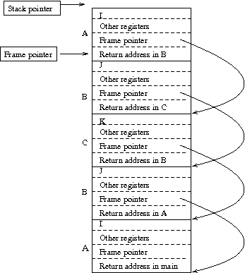
Stack of Activation Records
main { A() }
int A();
{ int I; … B() …}
int B()
{ int J; ... C(); A(); …}
int C()
{ int K; … B() … }
main calls A calls B calls C calls B calls A.

Slide 7
Local variable
The address of a local variable in the active function is a known offset from the FP.

Slide 8
Calling protocol: A calls B(X,Y)
A pushes values of X, Y onto stack
A pushes values of registers (including FP) onto stack
PUSHJ B --- Machine instruction pushes PC++ (address of next instruction in A) onto stack, jumps to starting address in B.
FP = SP – 4
SP += size of B’s local variables
B begins execution

Slide 9
Function return protocol
B stores value to be returned in a register.
SP -= size of B’s local variables (deallocate local variables)
POPJ (PC = pop stack --- next address in A)
Pop values from stack to registers (including FP)

Slide 10
Semi-dynamic arrays
In Ada and some other languages, one can have an array local to a procedure whose size is determined when the procedure is entered. (Scott p. 353-355)
procedure foo(N : in integer)
M1, M2: array (1 .. N) of integer;

Slide 11
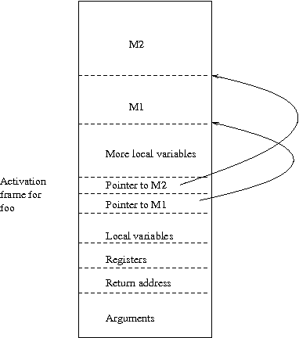

Slide 12
Resolving reference
To resolve reference to M2[I]:
Pointer to M2 is known offset from FP.
Address of M2[I] == value of pointer + I.

Slide 13
Dynamic memory
Resolving reference:
If a local variable is a dynamic entity, then the actual entity is allocated from the heap, and a pointer to the entity is stored in the activation record on the stack.

Slide 14
Dynamic memory allocation
Free list: List of free blocks
Allocation algorithm: On request for allocation, choose a free block.
Fragmentation: Disconnected blocks of memory, all too small to satisfy the request.

Slide 15
Fixed size dynamic allocation
In LISP (at least old versions) all dynamic allocations were in 2 word record.
In that case, things are easy:
Free list: linked list of records.
Allocation: Pop the first record off the free list.
No fragmentation.

Slide 16
Variable sized dynamic allocation
Free list: Linked list of consecutive blocks of free space, labelled by size.
Allocation algorithms:
  First fit: Go through free list, find first block that is large enough.
  Best fit: Go through free list, find smallest block that is large enough.
Best fit requires more search, sometimes leads to more fragmentation.

Slide 17
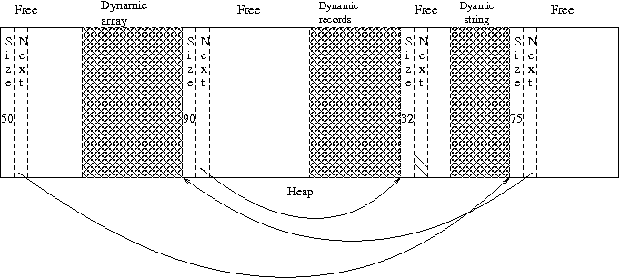

Slide 18
Multiple free list
Keep several free lists. The blocks on a single free list all have the same size. Different free lists have blocks of different sizes.
  powers of two: blocks of sizes 1, 2, 4, 8, 16 …
  Fibonacci numbers: blocks of size 1, 2, 3, 5, 8 …
On request for a structure of size N, find next standard size >= N, allocate first block.
Rapid allocation, lots of internal fragmentation.

Slide 19
Deallocation
Explicit deallocation (e.g. C, C++). Very error prone. If structure S is allocated, then deallocated, then the space is used for structure T, then the program accesses the space as S, the resulting error can be catastrophic and very hard to debug.

Slide 20
Garbage collection
Structures are deallocated when the runtime executor determines that the program can no longer access them.
Reference counts
Mark and sweep
All garbage collection techniques require disciplined creation of pointers, and unambiguous typing.
(e.g. not as in C: “p = &a + 40;”)

Slide 21
Reference count
With each dynamic structure there is a record of how many pointers exist to that structure. Deallocate when the reference count falls to 0. Iterate if the deallocated structure points to something else.
Advantage: Happens incrementally. Low cost.
Disadvantage: Doesn’t work with circular structure. Can use:
  with structures that can’t contain pointers (e.g. dynamic strings)
  In languages that can’t create circular structures (e.g. restricted forms of LISP)

Slide 22
Mark and sweep
Any accessible structure is accessible via some expression in terms of variables on the stack (or symbol table etc. but some known entity).
Therefore:
Unmark every structure in the heap.
Follow every pointer in the stack to structure in the heap. Mark. Follow these pointers. Iterate.
Go through heap, deallocate any unmarked structure.

Slide 23
Problem with Garbage Collection (other than reference count)
Inevitably large CPU overhead.
Generally program execution has to halt during GC. Annoying for interactive programs; dangerous for real-time, safety critical programs (e.g. a program to detect and respond to meltdown in a nuclear reactor).

Slide 24
Hybrid approach
Use reference counts to deallocate.
When memory runs out, use mark and sweep (or other GC) to collect inaccessible circular structures.

